Slide 1
AZ-900T0x Module 03: Core Solutions
Notes:
Adjust the cover for either AZ-900T00 or AZ-900T01.
This content in SkillPipe is now aligned with the content in Learn. The notes section of the PPT will call out any free Learn sandbox exercises available and provide direct links that can be shared with students (if they are not able to create a free Azure account and/or are not following along in Learn).
https://docs.microsoft.com/en-us/learn/paths/az-900-describe-core-solutions-management-tools-azure/

Slide 2

Module Outline
Notes:
Learn and SkillPipe content order note:
Slides 1-5
https://docs.microsoft.com/en-us/learn/modules/iot-fundamentals/1-introduction

Slide 3

Module 03 – Outline
You will learn the following concepts:
Core Azure solutions
IoT to Azure Sphere
Synapse Analytics to Databricks
AI / ML
Azure management tools
Portal, PowerShell, CLI, and others
Advisor, Monitor, and Service Health
Notes:
Learn and SkillPipe content order note:
Slides 1-5
https://docs.microsoft.com/en-us/learn/modules/iot-fundamentals/1-introduction

Slide 4

Azure solutions
Notes:
Learn and SkillPipe content order note:
Slides 1-5
https://docs.microsoft.com/en-us/learn/modules/iot-fundamentals/1-introduction

Slide 5
Azure Solutions - Objective Domain
Describe the benefits and usage of:
Internet of Things (IoT) Hub, IoT Central, and Azure Sphere
Azure Synapse Analytics, HDInsight, and Azure Databricks
Azure Machine Learning, Cognitive Services, and Azure Bot Service
Serverless computing solutions that include Azure Functions and Logic Apps
Azure DevOps, GitHub, GitHub Actions, and Azure DevTest Labs
Notes:
Learn and SkillPipe content order note:
Slides 1-5
https://docs.microsoft.com/en-us/learn/modules/iot-fundamentals/1-introduction

Slide 6



Azure Internet of Things
Internet of Things (IoT) is the ability for devices to garner and then relay information for data analysis.
Azure IoT Central is a fully managed global IoT SaaS solution that makes it easy to connect, monitor, and manage IoT assets at scale.
Azure IoT Hub is a managed service hosted in the cloud that acts as a central message hub for bi-directional communication between IoT applications and the devices it manages.
Azure Sphere is a secured, high-level application platform with built-in communication and security features for internet-connected devices.
Notes:
Azure IoT Central -- is a fully-managed global IoT SaaS solution that makes it easy to connect, monitor, and manage your IoT assets at scale.
Azure IoT Hub -- is a managed service hosted in the cloud that acts as a central message hub for bidirectional communication between your IoT application and the devices it manages.
Azure IoT Sphere -- is a comprehensive IoT security solution—including hardware, OS, and cloud components.
These are just three of our IoT offerings. Use the IoT Product Selector to determine what product is best for your situation - https://azure.microsoft.com/en-us/overview/iot/product-selector/
IoT Central - https://docs.microsoft.com/en-us/azure/iot-central/
Azure IoT Hub - https://docs.microsoft.com/en-us/azure/iot-hub/
Azure IoT Sphere - https://docs.microsoft.com/en-us/azure-sphere/
For a full list of IoT-related services available with Azure, and for context on when you use them, see the page https://azure.microsoft.com/en-us/overview/iot/
Learn and SkillPipe content order note:
Multiple Learn units cover the content in this slide
https://docs.microsoft.com/en-us/learn/modules/iot-fundamentals/1-introduction
https://docs.microsoft.com/en-us/learn/modules/iot-fundamentals/2-identify-product-options
https://docs.microsoft.com/en-us/learn/modules/iot-fundamentals/3-analyze-decision-criteria
https://docs.microsoft.com/en-us/learn/modules/iot-fundamentals/4-use-iot-hub
https://docs.microsoft.com/en-us/learn/modules/iot-fundamentals/5-use-iot-central
https://docs.microsoft.com/en-us/learn/modules/iot-fundamentals/6-use-azure-sphere

Slide 7
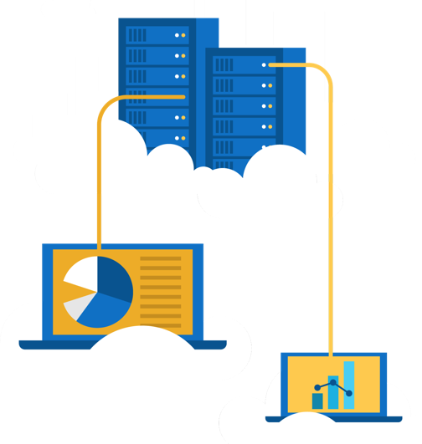
Walkthrough - Implement the Azure IoT Hub
Create an Azure IoT Hub in Azure Portal and configure the hub to authenticate a connection to an IoT device using the Raspberry Pi device simulator.
Create an IoT Hub.
Add an IoT device.
Test the device using the Raspberry Pi Simulator.
Notes:
What Is the Raspberry Pi?
The Raspberry Pi is a tiny computer about the size of a deck of cards. It uses what's called a system on a chip, which integrates the CPU and GPU in a single integrated circuit, with the RAM, USB ports, and other components soldered onto the board for an all-in-one package.
The nonprofit Raspberry Pi Foundation originally designed the Pi as an inexpensive computer for teaching programming, but it quickly became popular among DIYers looking for a more powerful brain in their electronics projects.

Slide 8




Big data and analytics
Azure Synapse Analytics
Azure HDInsight
Azure Databricks
A cloud-based Enterprise Data Warehouse.
A fully-managed, open-source analytics service for enterprises.
Apache Spark based analytics service.
Notes:
Azure Synapse Analytics provides limitless analytics service that brings together enterprise data warehousing and Big Data analytics.
Azure HDInsight is a fully-managed, open-source analytics service for enterprises. It is a cloud service that makes it easier, faster, and more cost-effective to process massive amounts of data.
Azure DataBricks is a fast, easy, and collaborative Apache Spark based analytics service.
Get more information on each of these topics
Azure SQL Data Warehouse - https://azure.microsoft.com/en-us/services/sql-data-warehouse/
Azure HDInsight - https://azure.microsoft.com/en-us/services/hdinsight/
Azure Data Lake Analytics - https://azure.microsoft.com/en-us/services/data-lake-analytics/
Data and Analytics services - https://azure.microsoft.com/en-us/product-categories/analytics/
Learn and SkillPipe content order note:
This page was moved to mirror the PPT flow and slides in SkillPipe, but not in Learn. You can access the Learn unit here…
https://docs.microsoft.com/en-us/learn/modules/azure-database-fundamentals/azure-big-data-analytics

Slide 9



Artificial Intelligence & Machine Learning
Azure Machine Learning: cloud-based to develop, train, and deploy machine learning models.
Cognitive Services: quickly enable apps to see, hear, speak, understand, and interpret a user’s needs.
Azure Bot Service: develop intelligent, enterprise-grade bots.
Notes:
Azure Machine Learning service provides a cloud-based environment used to develop, train, test, deploy, manage, and track machine learning models.
Cognitive Services builds intelligent and supported algorithms into apps, websites, and bots to see, hear, speak, understand, and interpret your user needs.
Azure Bot Service develops intelligent, enterprise-grade bots that let you maintain control of your data.
Learn more at:
Azure Machine Learning Service - https://azure.microsoft.com/en-us/services/machine-learning-service/
Azure Machine Learning Studio - https://azure.microsoft.com/en-us/services/machine-learning-studio/
Note: For a full list of Artificial Intelligence and Machine Learning services available with Azure, see the AI + Machine Learning section on the https://azure.microsoft.com/en-us/overview/ai-platform/ page.
Learn and SkillPipe content order note:
Multiple Learn units cover the content in this slide
https://docs.microsoft.com/en-us/learn/modules/ai-machine-learning-fundamentals/1-introduction
https://docs.microsoft.com/en-us/learn/modules/ai-machine-learning-fundamentals/2-identify-product-options
https://docs.microsoft.com/en-us/learn/modules/ai-machine-learning-fundamentals/3-analyze-decision-criteria
https://docs.microsoft.com/en-us/learn/modules/ai-machine-learning-fundamentals/4-use-machine-learning
https://docs.microsoft.com/en-us/learn/modules/ai-machine-learning-fundamentals/5-use-cognitive-services
https://docs.microsoft.com/en-us/learn/modules/ai-machine-learning-fundamentals/6-use-bot-services

Slide 10


Serverless Computing
Azure Functions
Azure Logic Apps
Event based code running your service and not the underlying infrastructure.
Automate and orchestrate tasks, business processes, and workflows to integrate apps.
Notes:
Note: This topic is also introduced in Module 1, slide 23 (as it works well there), but is listed in the objective domain here.
Serverless computing is the evolution of cloud platforms in the direction of pure cloud native code. Serverless brings developers closer to business logic while insulating them from infrastructure concerns. It's a pattern that doesn't imply "no server" but rather, "less server." Serverless code is event-driven. Code may be triggered by anything from a traditional HTTP web request to a timer or the result of uploading a file. The infrastructure behind serverless allows for instant scale to meet elastic demands and offers micro-billing to truly "pay for what you use." Serverless requires a new way of thinking and approach to building applications and isn't the right solution for every problem.
Azure Functions is code running your service and not the underlying platform or infrastructure. Creates infrastructure based on an event.
Azure Logic Apps is a cloud service that helps you automate and orchestrate tasks, business processes, and workflows when you need to integrate apps, data, systems, and services.
Azure Event Grid is a fully-managed, intelligent event routing service that uses a publish-subscribe model for uniform event consumption.
Azure Functions - https://docs.microsoft.com/en-us/azure/azure-functions/
Azure Logic Apps - https://docs.microsoft.com/en-us/azure/logic-apps/
Azure Event Grid - https://docs.microsoft.com/en-us/azure/event-grid/
Note: For more details about serverless services available with Azure, see https://azure.microsoft.com/en-us/solutions/serverless/
Learn and SkillPipe content order note:
Multiple Learn units cover the content in this slide
https://docs.microsoft.com/en-us/learn/modules/serverless-fundamentals/1-introduction
https://docs.microsoft.com/en-us/learn/modules/serverless-fundamentals/2-identify-product-options
https://docs.microsoft.com/en-us/learn/modules/serverless-fundamentals/3-analyze-decision-criteria
https://docs.microsoft.com/en-us/learn/modules/serverless-fundamentals/4-use-azure-functions
https://docs.microsoft.com/en-us/learn/modules/serverless-fundamentals/5-use-azure-logic-apps

Slide 11
Walkthrough - Implement Azure Functions
Create a Function app with a Webhook to provide a Hello message with your name.
Create a Function app.
Create a HTTP triggered event function and test.
Notes:
The run-time stack is a data structure that is used by Python to execute programs. Python needs this run-time stack to maintain information about the state of your program as it executes.

Slide 12


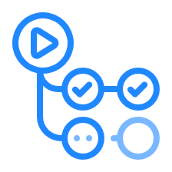

Develop your apps with DevOps and GitHub
Azure DevOps: development collaboration tools including pipelines, Kanban boards, and automated cloud-based load testing.
GitHub: software development hosting with version control, source code management, and bug/task management.
GitHub Actions for Azure: automate software workflow to build, test, and deploy from withing GitHub.
Azure DevTest Labs: quickly create environments in Azure while minimizing waste and controlling cost.
Notes:
Azure DevOps services provides development collaboration tools including pipelines, Git repositories, Kanban boards, and extensive automated and cloud-based load testing.
Azure DevTest Labs allows you to quickly create environments in Azure while minimizing waste and controlling cost.
GitHub is an American provides hosting for software development and version control using Git. It offers the distributed version control and source code management (SCM) functionality of Git, plus its own features. It provides access control and several collaboration features such as bug tracking, feature requests, task management, and wikis for every project.
GitHub Actions makes it easy to automate all your software workflows, now with world-class CI/CD. Build, test, and deploy your code right from GitHub. Make code reviews, branch management, and issue triaging work the way you want.
Azure DevOps Services - https://docs.microsoft.com/en-us/azure/devops/
Azure DevTest Labs - https://azure.microsoft.com/en-us/services/devtest-lab/
Note: For more general details on DevOps services available with Azure, see https://docs.microsoft.com/en-us/azure/#pivot=products&panel=devops
Learn and SkillPipe content order note:
Multiple Learn units cover the content in this slide
https://docs.microsoft.com/en-us/learn/modules/azure-devops-devtest-labs/1-introduction
https://docs.microsoft.com/en-us/learn/modules/azure-devops-devtest-labs/2-identify-product-options
https://docs.microsoft.com/en-us/learn/modules/azure-devops-devtest-labs/3-analyze-decision-criteria
https://docs.microsoft.com/en-us/learn/modules/azure-devops-devtest-labs/4-use-azure-devops
https://docs.microsoft.com/en-us/learn/modules/azure-devops-devtest-labs/5-use-github
https://docs.microsoft.com/en-us/learn/modules/azure-devops-devtest-labs/6-use-azure-devtest-labs

Slide 13

Azure management tools
Notes:
Learn and SkillPipe content order note:
Multiple Learn units cover the content in slide 13-15
https://docs.microsoft.com/en-us/learn/modules/management-fundamentals/1-introduction
https://docs.microsoft.com/en-us/learn/modules/management-fundamentals/2-identify-product-options
https://docs.microsoft.com/en-us/learn/modules/management-fundamentals/3-analyze-decision-criteria
https://docs.microsoft.com/en-us/learn/modules/management-fundamentals/4-use-azure-portal
https://docs.microsoft.com/en-us/learn/modules/management-fundamentals/5-use-azure-powershell
https://docs.microsoft.com/en-us/learn/modules/management-fundamentals/6-use-azure-cli
https://docs.microsoft.com/en-us/learn/modules/management-fundamentals/7-use-azure-mobile-app

Slide 14
Azure Management Tools - Objective Domain
Describe the functionality and usage of:
Azure Portal, Azure PowerShell, Azure CLI, Cloud Shell, and Azure Mobile App.
Azure Advisor.
Azure Resource Manager (ARM) templates.
Azure Monitor.
Azure Service Health.
Notes:
Learn and SkillPipe content order note:
Multiple Learn units cover the content in slide 13-15
https://docs.microsoft.com/en-us/learn/modules/management-fundamentals/1-introduction
https://docs.microsoft.com/en-us/learn/modules/management-fundamentals/2-identify-product-options
https://docs.microsoft.com/en-us/learn/modules/management-fundamentals/3-analyze-decision-criteria
https://docs.microsoft.com/en-us/learn/modules/management-fundamentals/4-use-azure-portal
https://docs.microsoft.com/en-us/learn/modules/management-fundamentals/5-use-azure-powershell
https://docs.microsoft.com/en-us/learn/modules/management-fundamentals/6-use-azure-cli
https://docs.microsoft.com/en-us/learn/modules/management-fundamentals/7-use-azure-mobile-app

Slide 15







Management tools available in Azure
Azure Portal
Azure PowerShell
Command-Line Interface (CLI)
Azure Mobile App
Azure REST API
Azure Cloud Shell
Azure Resource Manager (ARM)
Notes:
Learn and SkillPipe content order note:
Multiple Learn units cover the content in slide 13-15
https://docs.microsoft.com/en-us/learn/modules/management-fundamentals/1-introduction
https://docs.microsoft.com/en-us/learn/modules/management-fundamentals/2-identify-product-options
https://docs.microsoft.com/en-us/learn/modules/management-fundamentals/3-analyze-decision-criteria
https://docs.microsoft.com/en-us/learn/modules/management-fundamentals/4-use-azure-portal
https://docs.microsoft.com/en-us/learn/modules/management-fundamentals/5-use-azure-powershell
https://docs.microsoft.com/en-us/learn/modules/management-fundamentals/6-use-azure-cli
https://docs.microsoft.com/en-us/learn/modules/management-fundamentals/7-use-azure-mobile-app

Slide 16
Walkthrough – Create a VM with an ARM Template
Use the Azure QuickStart gallery to deploy a template that creates a virtual machine.
Explore the gallery and deploy a template.
Verify your virtual machine deployment.

Slide 17
Walkthrough - Create a VM with PowerShell
Install PowerShell locally, create a resource group and virtual machine, access and use the Cloud Shell, and review Azure Advisor recommendations.
Use PowerShell to create a resource group and virtual machine.
Execute PowerShell commands in the Cloud Shell.
Review Azure Advisor Recommendations.

Slide 18
Walkthrough - Create a VM with the Azure CLI
Install the Azure CLI locally, create a resource group and virtual machine, use the Cloud Shell, and review Azure Advisor recommendations.
Install the CLI locally.
Use the CLI to create a resource group and virtual machine.
Execute commands in the Cloud Shell.
Review Azure Advisor Recommendations.

Slide 19

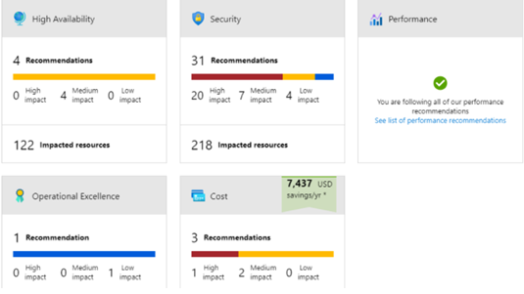
Azure Advisor
Azure Advisor analyzes deployed Azure resources and makes recommendations based on best practices to optimize Azure deployments.
Reliability
Security
Performance
Cost
Operational Excellence
© Copyright Microsoft Corporation. All rights reserved.
Notes:
Get proactive, actionable, and personalized best practice recommendations.
Improve the performance, security, and availability of your resources.
Identify opportunities to reduce your Azure costs.
Azure Advisor - https://docs.microsoft.com/en-us/azure/advisor/
Learn and SkillPipe content order note:
Multiple Learn units cover the content in slide 19-23
https://docs.microsoft.com/en-us/learn/modules/monitoring-fundamentals/1-introduction
https://docs.microsoft.com/en-us/learn/modules/monitoring-fundamentals/2-identify-product-options
https://docs.microsoft.com/en-us/learn/modules/monitoring-fundamentals/3-analyze-decision-criteria
https://docs.microsoft.com/en-us/learn/modules/monitoring-fundamentals/4-use-azure-advisor
https://docs.microsoft.com/en-us/learn/modules/monitoring-fundamentals/5-use-azure-monitor
https://docs.microsoft.com/en-us/learn/modules/monitoring-fundamentals/6-use-azure-service-health

Slide 20

Azure Monitor
Azure Monitor maximizes the availability and performance of applications and services by collecting, analyzing, and acting on telemetry from cloud and on-premises environments.
Application Insights
Log Analytics
Smart Alerts
Automation Actions
Customized Dashboards
Notes:
Collect, analyse, and act on telemetry from cloud and on-premises environments, to maximize your applications’ availability and performance.
Starts collecting data as soon as you create an Azure subscription and add resources.
Activity Logs record all resource creation and modification events.
Metrics measure resource performance and consumption.
Add an Azure monitor agent to collect operational data for a resource.
Azure Monitor - https://azure.microsoft.com/en-us/services/monitor/
Learn and SkillPipe content order note:
Multiple Learn units cover the content in slide 19-23
https://docs.microsoft.com/en-us/learn/modules/monitoring-fundamentals/1-introduction
https://docs.microsoft.com/en-us/learn/modules/monitoring-fundamentals/2-identify-product-options
https://docs.microsoft.com/en-us/learn/modules/monitoring-fundamentals/3-analyze-decision-criteria
https://docs.microsoft.com/en-us/learn/modules/monitoring-fundamentals/4-use-azure-advisor
https://docs.microsoft.com/en-us/learn/modules/monitoring-fundamentals/5-use-azure-monitor
https://docs.microsoft.com/en-us/learn/modules/monitoring-fundamentals/6-use-azure-service-health

Slide 21
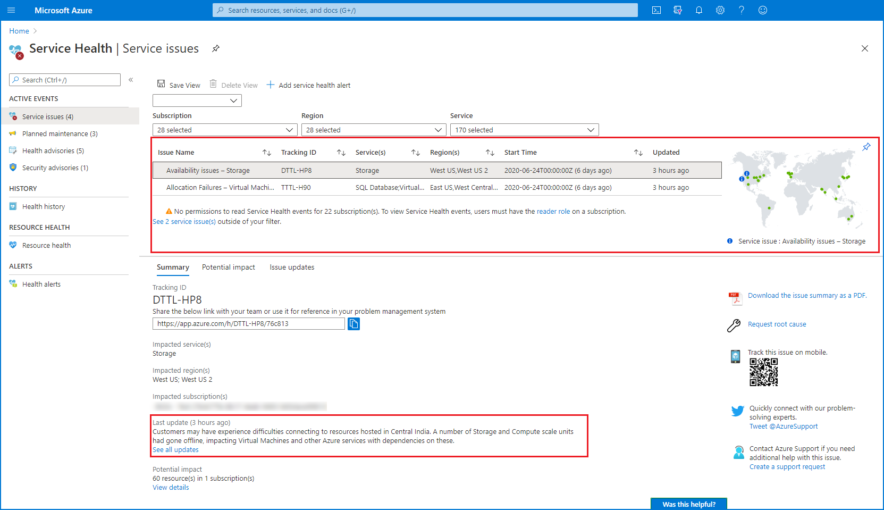

Azure Service Health
Evaluate the impact of Azure service issues with personalized guidance and support, notifications, and issue resolution updates.
Notes:
https://docs.microsoft.com/azure/service-health/service-health-overview
Collect, analyse, and act on telemetry from cloud and on-premises environments, to maximize your applications’ availability and performance.
Starts collecting data as soon as you create an Azure subscription and add resources.
Activity Logs record all resource creation and modification events.
Metrics measure resource performance and consumption.
Add an Azure monitor agent to collect operational data for a resource.
Azure Service Health - https://azure.microsoft.com/en-us/services/monitor/
Learn and SkillPipe content order note:
Multiple Learn units cover the content in slide 19-23
https://docs.microsoft.com/en-us/learn/modules/monitoring-fundamentals/1-introduction
https://docs.microsoft.com/en-us/learn/modules/monitoring-fundamentals/2-identify-product-options
https://docs.microsoft.com/en-us/learn/modules/monitoring-fundamentals/3-analyze-decision-criteria
https://docs.microsoft.com/en-us/learn/modules/monitoring-fundamentals/4-use-azure-advisor
https://docs.microsoft.com/en-us/learn/modules/monitoring-fundamentals/5-use-azure-monitor
https://docs.microsoft.com/en-us/learn/modules/monitoring-fundamentals/6-use-azure-service-health

Slide 22
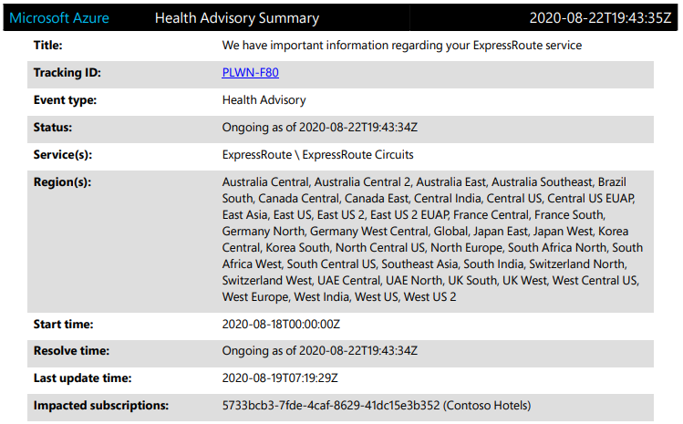
Azure Service Health (continued)
Azure Service Health provides a personalized view of the health of Azure services and the regions being used.
Communication regarding outages
Planned maintenance
Other health advisories
Notes:
Collect, analyse, and act on telemetry from cloud and on-premises environments, to maximize your applications’ availability and performance.
Starts collecting data as soon as you create an Azure subscription and add resources.
Activity Logs record all resource creation and modification events.
Metrics measure resource performance and consumption.
Add an Azure monitor agent to collect operational data for a resource.
Azure Service Health - https://azure.microsoft.com/en-us/services/monitor/
Learn and SkillPipe content order note:
Multiple Learn units cover the content in slide 19-23
https://docs.microsoft.com/en-us/learn/modules/monitoring-fundamentals/1-introduction
https://docs.microsoft.com/en-us/learn/modules/monitoring-fundamentals/2-identify-product-options
https://docs.microsoft.com/en-us/learn/modules/monitoring-fundamentals/3-analyze-decision-criteria
https://docs.microsoft.com/en-us/learn/modules/monitoring-fundamentals/4-use-azure-advisor
https://docs.microsoft.com/en-us/learn/modules/monitoring-fundamentals/5-use-azure-monitor
https://docs.microsoft.com/en-us/learn/modules/monitoring-fundamentals/6-use-azure-service-health

Slide 23
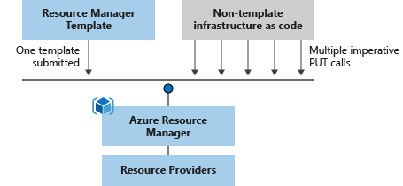
Azure Resource Manager (ARM) templates
Azure Resource Manager (ARM) templates are JavaScript Object Notation (JSON) files that can be used to create and deploy Azure infrastructure without having to write programing commands.
Declarative syntax
Repeatable results
Orchestration
Modular files
Built-in validation
Exportable code
Notes:
https://azure.microsoft.com/en-us/features/resource-manager/
https://docs.microsoft.com/en-us/azure/azure-resource-manager/management/overview
https://docs.microsoft.com/en-us/azure/azure-resource-manager/templates/overview
Deploy app resources Azure Resource Manager enables you to repeatedly deploy your app and have confidence your resources are deployed in a consistent state. You define the infrastructure and dependencies for your app in a single declarative template. This template is flexible enough to use for all of your environments such as test, staging or production. If you create a solution from the Azure Marketplace, the solution will automatically include a template that you can use for your app.
Organize resources
Azure Resource Manager makes it easy for you to manage and visualize resources in your app. You no longer have to deploy parts of your app separately and then manually stitch them together. You put resources with a common lifecycle into a resource group that can be deployed or deleted in a single action. You can see which resources are linked by a dependency. You can apply tags to resources to categorize them for management tasks, such as billing.
Control access to resources
With Azure Resource Manager, you can control who in your organization can perform actions on the resources. You manage permissions by defining roles and adding users or groups to the roles. For critical resources, you can apply an explicit lock that prevents users from deleting or modifying the resource. Azure Resource Manager logs all user actions so you can audit those actions. For each action, the audit log contains information about the user, time, events, and status.
Learn and SkillPipe content order note:
Multiple Learn units cover the content in slide 19-23
https://docs.microsoft.com/en-us/learn/modules/monitoring-fundamentals/1-introduction
https://docs.microsoft.com/en-us/learn/modules/monitoring-fundamentals/2-identify-product-options
https://docs.microsoft.com/en-us/learn/modules/monitoring-fundamentals/3-analyze-decision-criteria
https://docs.microsoft.com/en-us/learn/modules/monitoring-fundamentals/4-use-azure-advisor
https://docs.microsoft.com/en-us/learn/modules/monitoring-fundamentals/5-use-azure-monitor
https://docs.microsoft.com/en-us/learn/modules/monitoring-fundamentals/6-use-azure-service-health

Slide 24


Knowledge Check
Which one?
A). Azure Portal
B). PowerShell
C). Local Tool
Populate with instructions to use the polling tool of your choice
Module 3
Use your Smartphones or Mobile Devices
Go to (insert polling app link of your choice)
Enter Code: 123-45-678
Please participate in the quiz for this section
Notes:
WWL recommends using polling to be completed for every 7 – 10 slides and preferably at the end of each section. This helps break classes up and adds more interactivity especially for remote classes.
In order to promote interactivity, WWL suggests the use of Mentimeter, Kahoot or a similar polling technology. Please feel free to adjust this slide as needed and populate with the instructions based on the polling tool of your choice.
Learn/SkillPipe note:
SkillPipe has a Module 3 review questions slide, while Learn has Knowledge checks individually through Learn modules that follow this PPT.
https://docs.microsoft.com/en-us/learn/modules/iot-fundamentals/7-knowledge-check
https://docs.microsoft.com/en-us/learn/modules/ai-machine-learning-fundamentals/7-knowledge-check
https://docs.microsoft.com/en-us/learn/modules/serverless-fundamentals/6-knowledge-check
https://docs.microsoft.com/en-us/learn/modules/azure-devops-devtest-labs/7-knowledge-check
https://docs.microsoft.com/en-us/learn/modules/management-fundamentals/9-knowledge-check
https://docs.microsoft.com/en-us/learn/modules/monitoring-fundamentals/7-knowledge-check

Slide 25

Module 03 Review
Azure services: IoT, big data, analytics, and development tools.
Azure Resource Manager.
Azure Monitoring tools.
Microsoft Learn Modules (docs.microsoft.com/Learn)
Notes:
Learn/SkillPipe note:
SkillPipe has a Module 3 summary slide, while Learn has summary units individually through Learn modules that follow this PPT.
https://docs.microsoft.com/en-us/learn/modules/iot-fundamentals/summary
https://docs.microsoft.com/en-us/learn/modules/ai-machine-learning-fundamentals/summary
https://docs.microsoft.com/en-us/learn/modules/serverless-fundamentals/summary
https://docs.microsoft.com/en-us/learn/modules/azure-devops-devtest-labs/summary
https://docs.microsoft.com/en-us/learn/modules/management-fundamentals/summary
https://docs.microsoft.com/en-us/learn/modules/monitoring-fundamentals/summary

